Slide 1

INTERNATIONAL UNIVERSITY – VNU HCMC FINAL GAME PROJECT (2024-2025 S1) IT069IU OBJECT-ORIENTED PROGRAMMING
ANIMAL KILLING
Group [09] – Test room: [LA1.604]
Test date: [24 December 2024]

Slide 2












OUR TEAM
Thanh Truc
Bao Tran

Slide 3
TABLE OF CONTENTS
1.
IDEAS & TECHNIQUES
2.
DESIGN AND IMPLEMENTATION
3.
GAME DESIGN
4.
CONCLUSION

Slide 4




01.
Ideas and TechnIques

Slide 5
MotIVatIon
The Animal Killing project is inspired by the popular chicken shooting games found on platforms like Google Play and the App Store. Built using object-oriented programming principles, the game offers a fresh take on the classic gameplay, incorporating modern mechanics and enhancements to deliver an engaging and immersive experience for players.

Slide 6
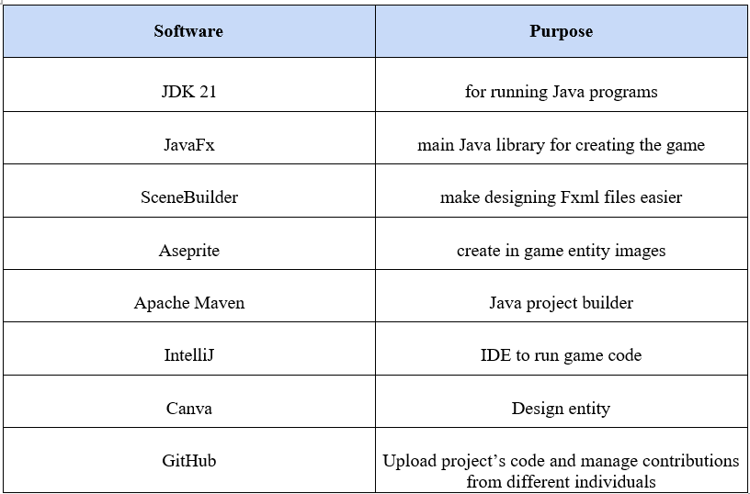
WorkIng tools, platform

Slide 7
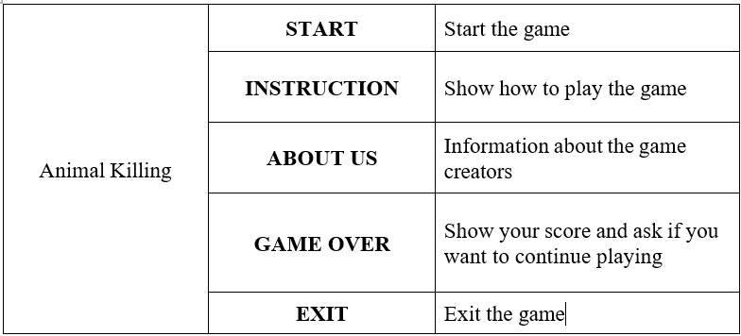
Use Case ScenarIo

Slide 8
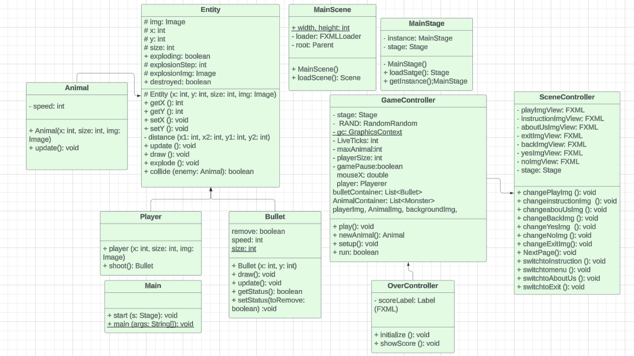
UML

Slide 9





DESIGN AND IMPLEMENTATION
02.

Slide 10
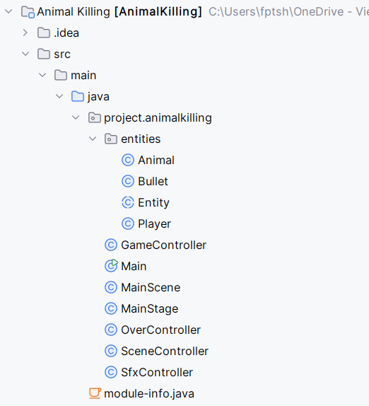
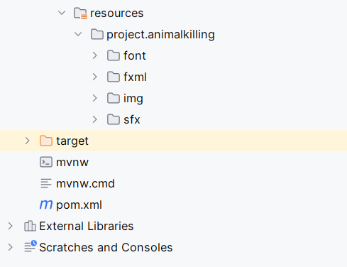
Project Structure

Slide 11
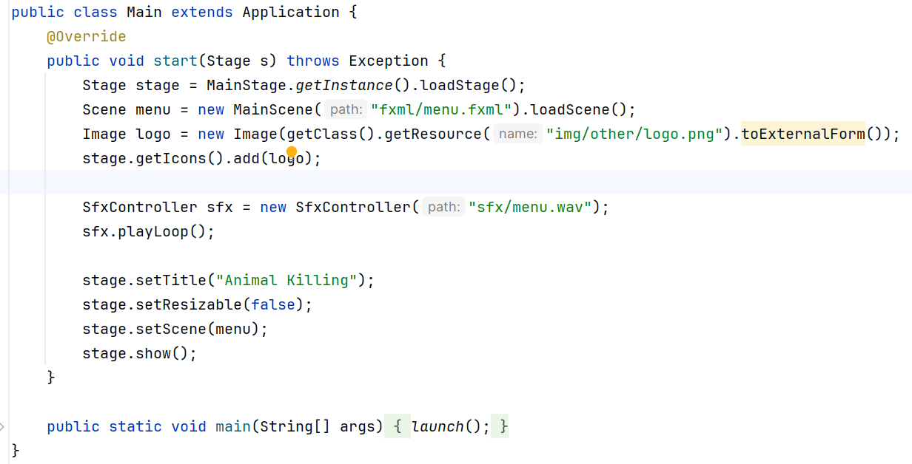
class Structure
1.MaIn

Slide 12
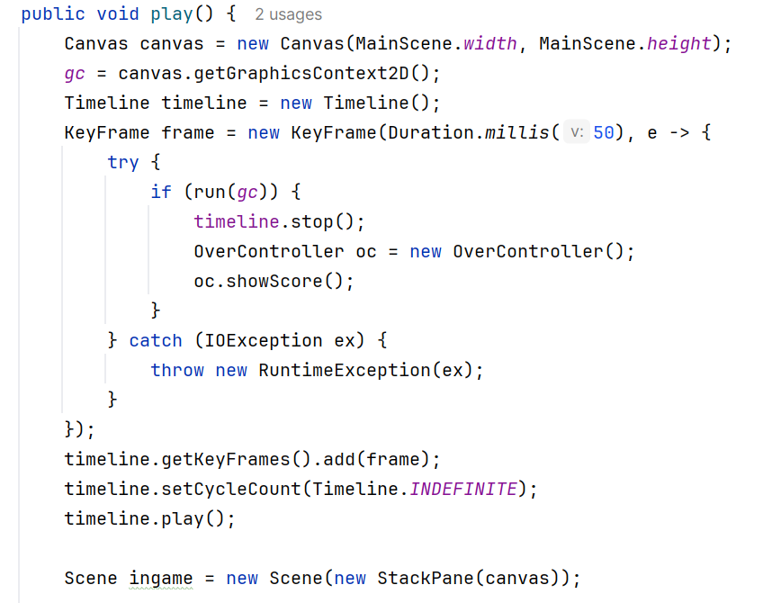
class Structure
2.GameCONTROLLER

Slide 13
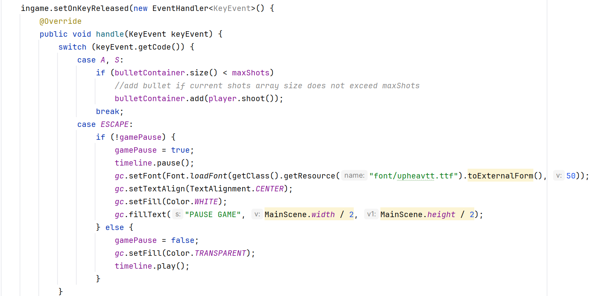
class Structure
2.GameCONTROLLER

Slide 14
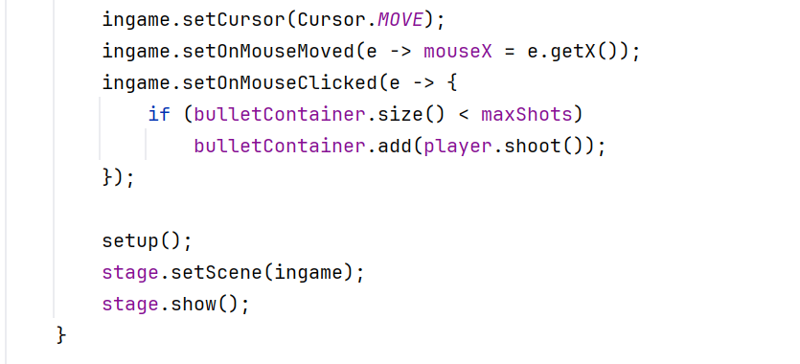
class Structure
2.GameCONTROLLER

Slide 15
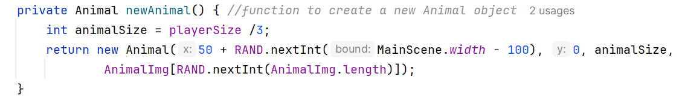
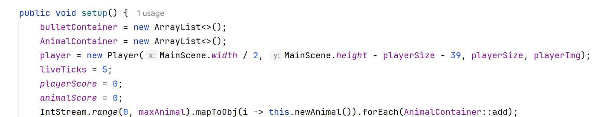
class Structure
2.GameCONTROLLER

Slide 16
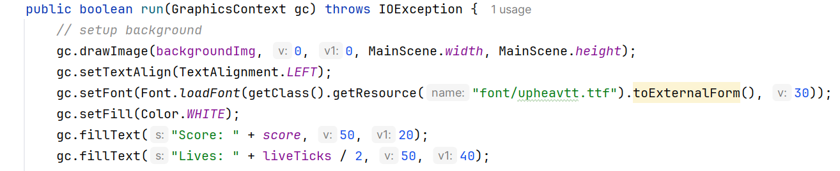
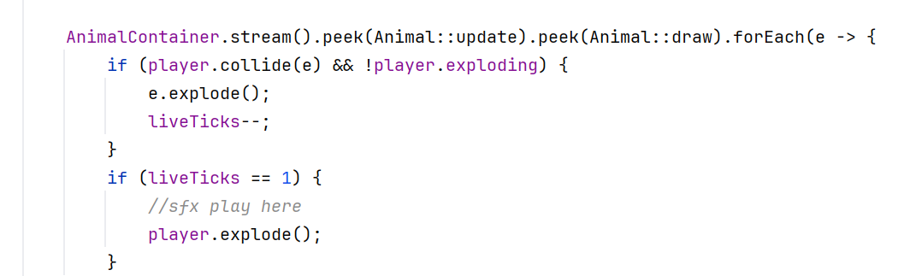
class Structure
2.GameCONTROLLER

Slide 17
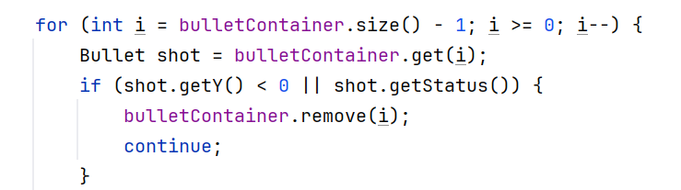
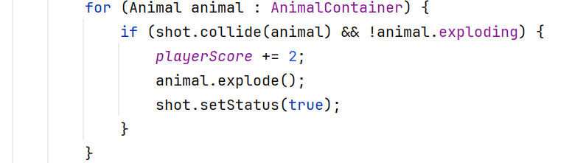
class Structure
2.GameCONTROLLER

Slide 18
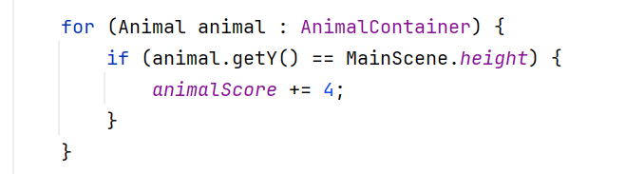
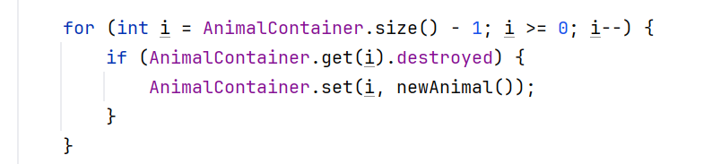
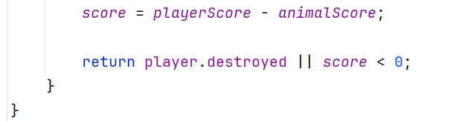
class Structure
2.GameCONTROLLER

Slide 19
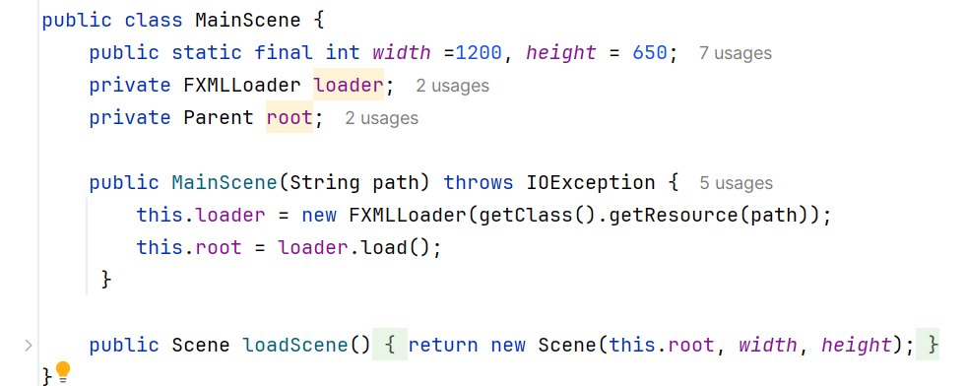
class Structure
3.MAINSCENE

Slide 20
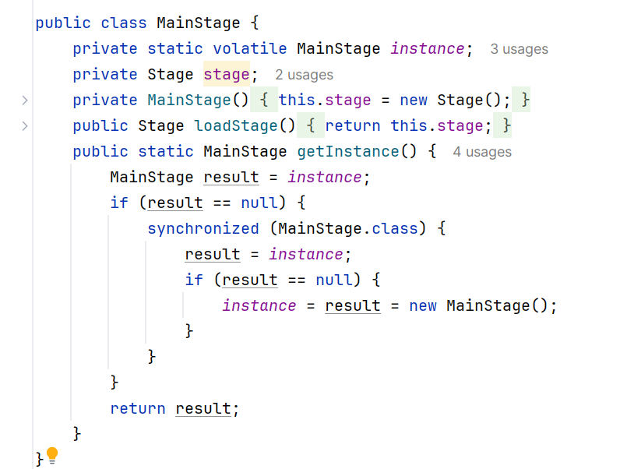
class Structure
4.MAINSTAGE

Slide 21
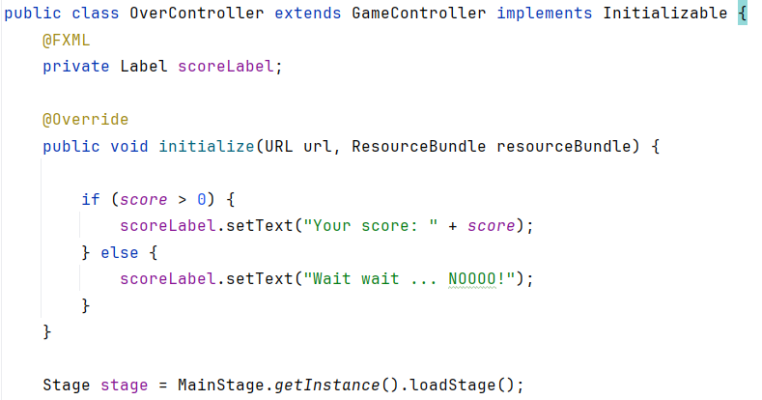
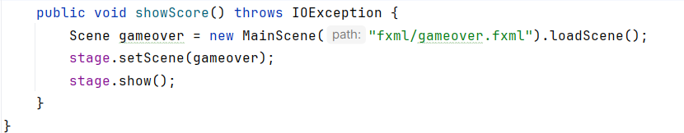
class Structure
5.OVERCONTROLLER

Slide 22
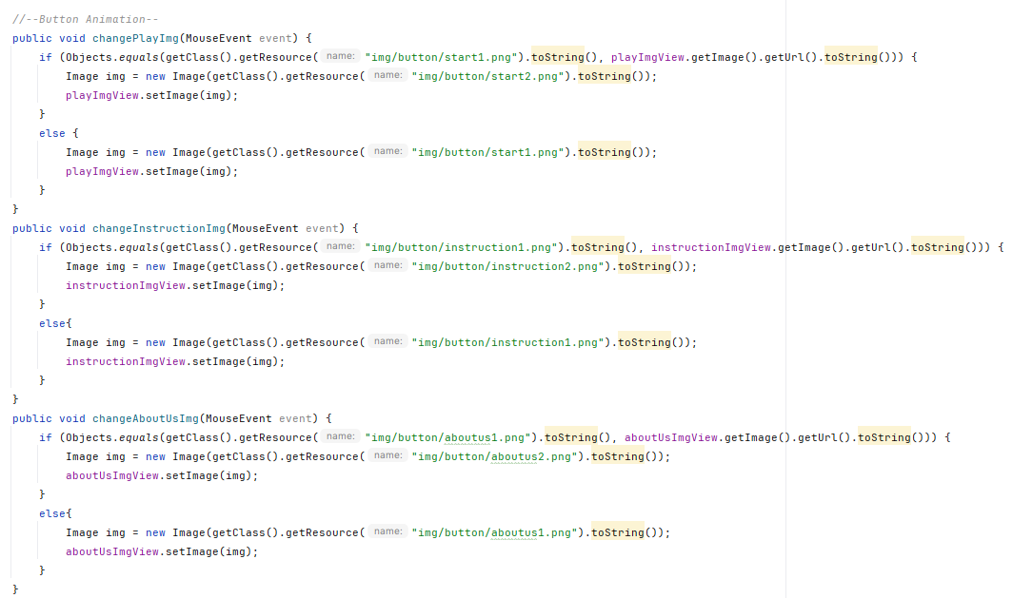
class Structure
6.SCENECONTROLLER

Slide 23
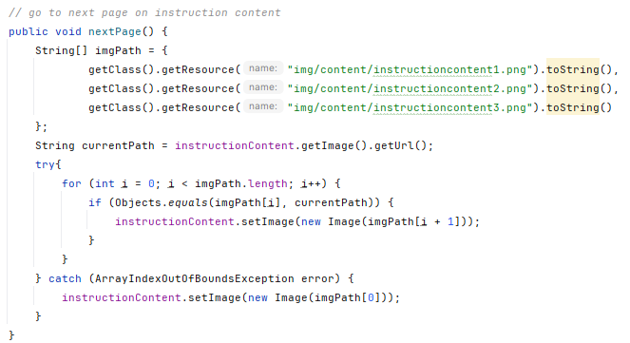
class Structure
6.SCENECONTROLLER

Slide 24
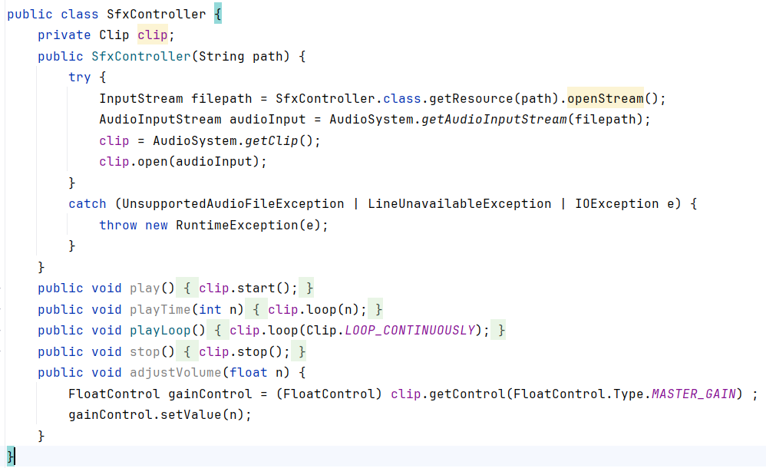
class Structure
6.SfxCONTROLLER

Slide 25
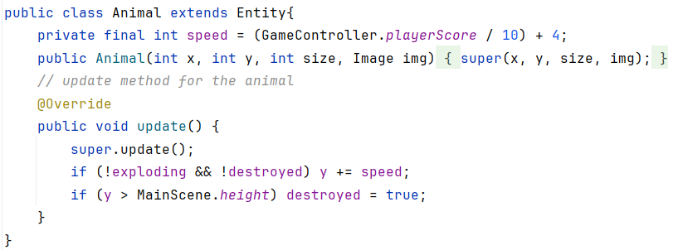
class Structure
8.AnImal

Slide 26
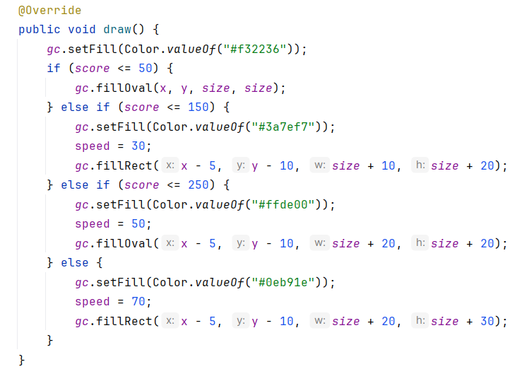
class Structure
9.Bullet

Slide 27
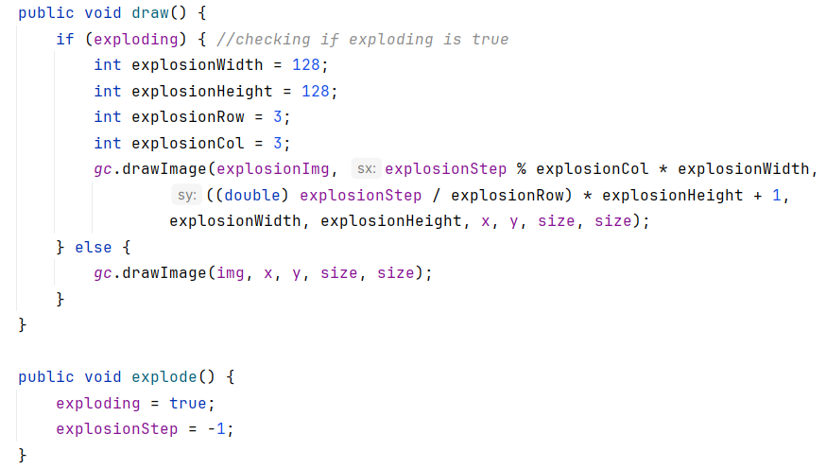
class Structure
10.EntITy

Slide 28
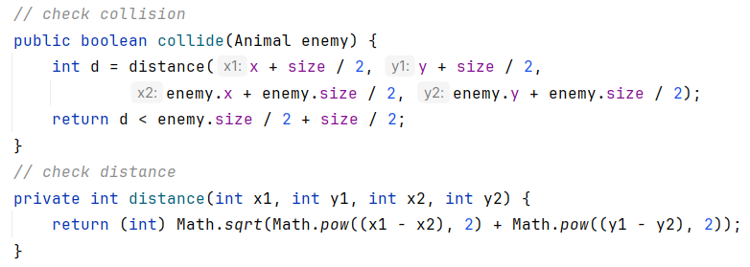
class Structure
10.EntITy

Slide 29
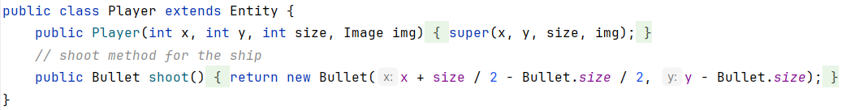
class Structure
11.PLAYER

Slide 30





03.
Game DESIGN

Slide 31



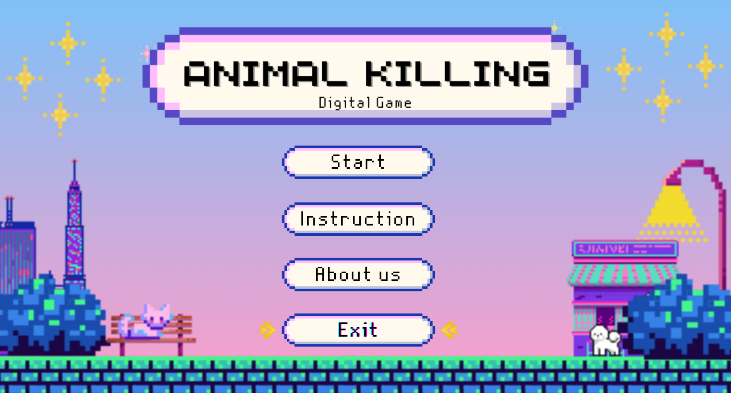
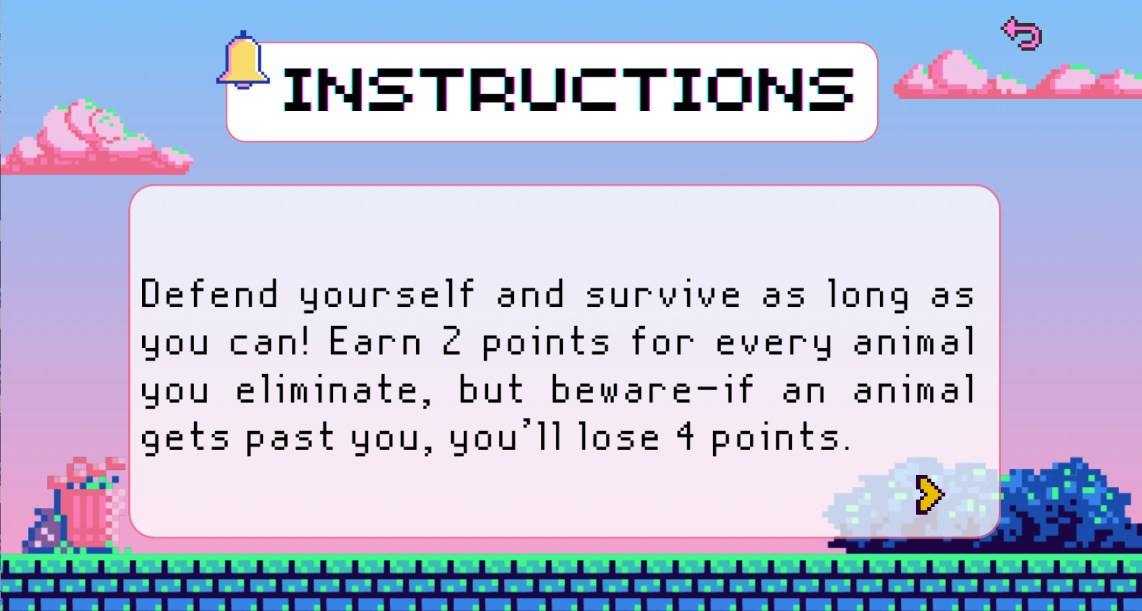

BACKGROUND
MaIN MENU
INSTRUCTIONS
ABOUT US

Slide 32


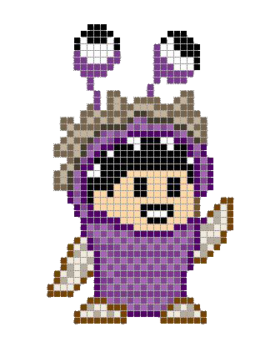



CHARACTeRS

Slide 33
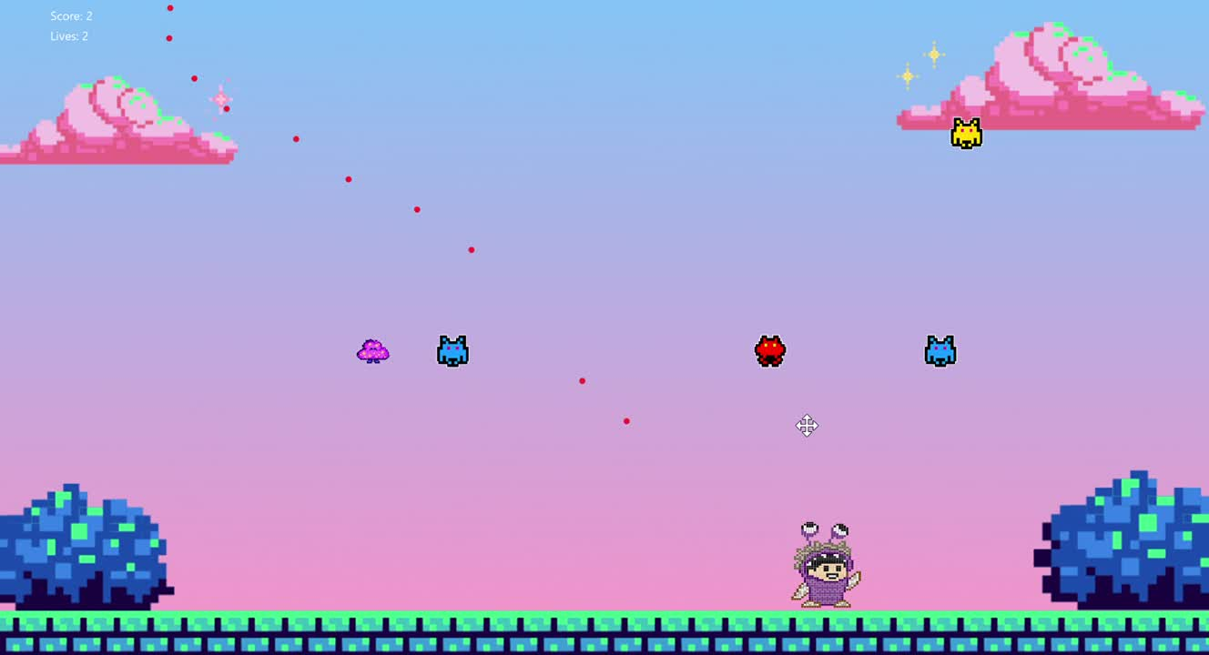
GAMEPLAY DEMO

Slide 34






05.
CONCLUSION

Slide 35

ACHIEVEMENT
Effective Use of OOP Principles
User Interface Design
Game Logic Development

Slide 36
FUTURE WORK
Level Progression
Resurrection Mechanic
Player Selection or Random Mode

Slide 37
REFERENCEs
1. mostafaHegab. (n.d.). mostafaHegab/Monster-Inc: Simple Monster Inc Game with
JAVA. Retrieved from https://github.com/mostafaHegab/Chicken-Invaders
2. UML class: Lucidchart. (n.d.). Retrieved from https://lucid.app/lucidchart/c6e383ae-e074-4fc5-ae37-65484a9a7a34/edit?invitationId=inv_0 a814f23-793c-4559-a23f-30c2dc288661&page=HWEp-vi-RSFO#
3. Best 55+ 8. (n.d.). Retrieved from https://wallpapercave.com/w/wp7872568
4. Programming Space Invaders in Java (fx) Tutorial 1/2. (2019). Retrieved from https://www.youtube.com/watch?v=0szmaHH1hno&list=WL&index=4&t=18s
5. Programming Space Invaders in Java (fx) Tutorial 2/2. (2019). Retrieved from https://www.youtube.com/watch?v=dzcQgv9hqXI
6. (N.d.). Retrieved from https://openjfx.io/#
7. Super Pixel Vintage Gaming Presentation. (n.d.). Retrieved from https://slidesgo.com/theme/super-pixel-vintage-gaming?fbclid=IwAR20XFCnI-9j9m-fXtvFr
Vnvp8Cf6NYDbKq0FbsinzJ7hjRIAdrVbHhHqkQ

Slide 38





THANK YOU
Q & A
See You Next Time!

